Slide 1
Pfizer formulation

Slide 2
Problem requirements
Objective 1: to minimize the distance travelled
Objective 2: to minimize disruption from the current allocation
The workload of a sales rep should be between 0.8 and 1.2

Slide 3
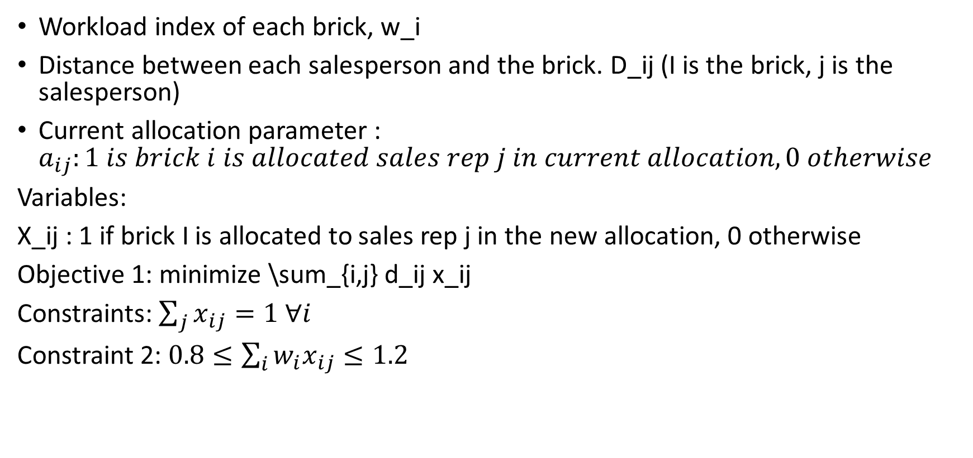
Data given
Workload index of each brick, w_i
Distance between each salesperson and the brick. D_ij (I is the brick, j is the salesperson)
Current allocation parameter : $a_{ij}:1 is brick i is allocated sales rep j in current allocation, 0 otherwise$
Variables:
X_ij : 1 if brick I is allocated to sales rep j in the new allocation, 0 otherwise
Objective 1: minimize \sum_{i,j} d_ij x_ij
Constraints: $\sum_{j}{x_{ij}=1 ∀i}$
Constraint 2: $0.8≤\sum_{i}{w_{i}x_{ij}≤1.2}$

Slide 4


Objective 2
Minimize disruption:$\sum_{i}{\sum_{j}{w_{i}{(1 −a_{ij})x}_{ij}/\sum_{i}{w_{i}}}}$*100
Obj: $z_{1}+εz_{2}$
$$z_{2}≤z_{2}^{∗} −ε_{1}$$
$$ε=0.00001$$
$$ε_{1}=0.01$$

